Slide 1
ANZ transaction data
Shonil Dabreo

Slide 2
Title of Contents
Introduction
Insights
Conclusion

Slide 3
Introduction
The data is sourced from ANZ which contains 3 months of transactions for 100 hypothetical customers.
The task is to perform Exploratory Data Analysis by gathering some insights on this data.
The data is pre-processed to have a glimpse at the structure of the data. Data visualization is done to understand the behavior of customers.

Slide 4
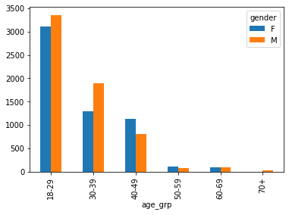
Insights
Fig 1 Relation between age and gender.

Slide 5
Insights
As we can see in the Fig 1, how age is related to gender in the customer transactions data.
As people age, the numbers of population spending their money through ANZ bank reduces. The data is rightly skewed. People between 18-29 age group tends to spend more, whereas, aged people above 70 tend to spend less of their money.
Through this, for e.g, ANZ team in correspondence with any hospital could offer medical schemes to aged people to increase their finances.

Slide 6
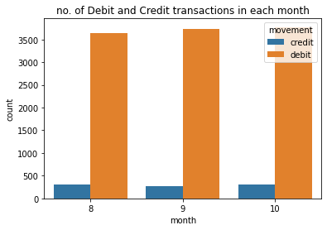
Insights
Fig 2 No of Debit & Credit transactions in each month

Slide 7
Insights
As we can see in the Fig 2, the no of credit & debit card transactions being carried out for the course of 3 months.
The debit card transactions are higher than credit card transactions in all 3 months. Moreover, the debit card transactions in September are a bit higher than in other months.
Since most of the fraudulent transactions are through debit cards, ANZ team could add discount offers to increase the usage of credit cards. This will also help reduce the debit card frauds.

Slide 8
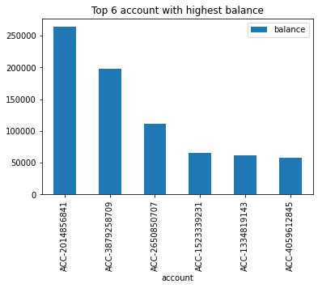
Insights
Fig 3 Accounts with highest balance.

Slide 9
Insights
As we can see in the Fig 3, top 6 accounts with highest balance.
These are the account numbers with highest balance on average between 3 months.
ANZ team can create a dashboard for people that tracks their spending, recommends ways to maintain their savings (financial health), or alert for any potential frauds. This will help them maintain their incoming, outgoing transactions and savings.

Slide 10
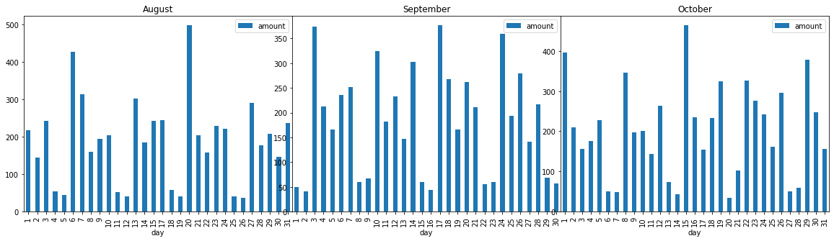
Insights
Fig 4 Daily average amount flow for 3 months.

Slide 11
Insights
As we can see in the Fig 4, daily average amount flow for 3 months.
These are the average transaction amounts that are processed daily. In August, the highest transaction amounts were on Saturdays (6th day). While, in September, the highest transaction amounts were on Wednesdays (3rd day). Also, in September, the highest transaction amounts were on Mondays (1st day).
The days with low transaction amounts, ANZ team partnering with any retail company could offer new products or combination of other products at some discounts. This will increase the average transaction amount.

Slide 12
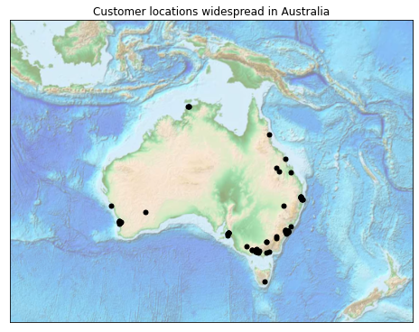
Insights
Fig 5 Customer locations in Australia.

Slide 13
Insights
As we can see in the Fig 5, customer locations widespread in Australia.
These are the locations of ANZ customers in Australia. There is a cluster of customers in South East Australia (Melbourne and Sydney). Majority of the customers tend to be from state capital.
Though an expensive approach, for the benefit of regional customers, ANZ team could build an ATM machines with a screen to do basic teller operations face-to-face. These intelligent ATM machines could be placed in different branch locations and thus expanding the reach to its customers.

Slide 14
Conclusion
Going through all the visualizations and understanding the behavior of the customers, the ANZ team can take an informed decisions to drive their finances as well as increase the reach, support, safety and financial health of the customers.
This could also help merchants and small businesses that use ANZ bank.
Additionally, carrying out a survey or interview of customers would help the ANZ team understand the gaps or problems from the customers point of view. Matching the results with the data analysis would assist in understanding the differences as a result of considering the unpredictability or uncertainty in the data.

Slide 15
Thank you!!

